Slide 1
Session 2
NAD1001: INTRODUCTION TO ARCHITECTURAL DESIGN

Slide 3
Introduction to Precedent Case Studies
Definition: Precedent case studies (also known as case studies) in architecture refer to the systematic investigation and analysis of existing buildings, structures, or projects to gather insights and inspiration for new design projects. This approach involves examining and understanding the choices made by other architects regarding space, materials, structure, and context

Slide 4
Importance of Precedent Case Study
1. Foundation of Design: historical context, technical solutions
2. Innovation and Creativity: inspiration, adaptation and modification
3. Problem Solving: solve similar design problems, comparative analysis
4. Communication and Presentation: visual and conceptual design, justification for desig
5. Learning from Others: learning tool, sustainable/innovative approaches in design

Slide 5
Selecting Architectural Precedents
Criteria for selecting relevant precedents:
historical significance
design complexity
contextual relevance
Examples of well-known architects:
https://www.architecturelab.net/architect/famous/
Examples of well-known projects:
https://www.wallpaper.com/architecture/the-finest-modernist-architecture-across-the-globe#:~:text=Some%20of%20the%2020th%20century's,are%20intrinsically%20linked%20to%20it

Slide 6
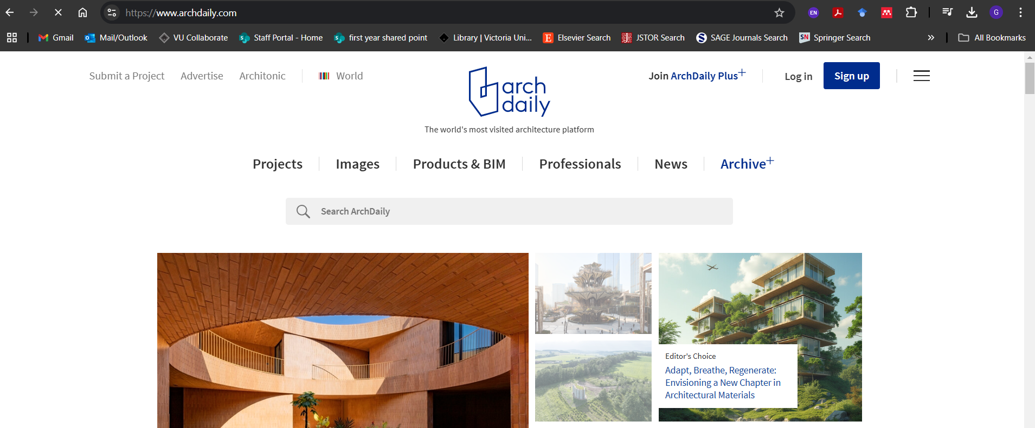
Selecting Architectural Precedents - Resources
ArchDaily

Slide 7
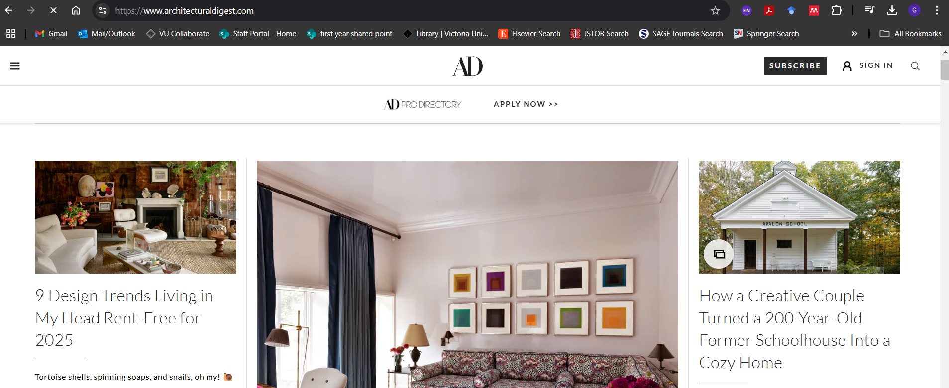
Selecting Architectural Precedents - Resources
Architectural Digest

Slide 8
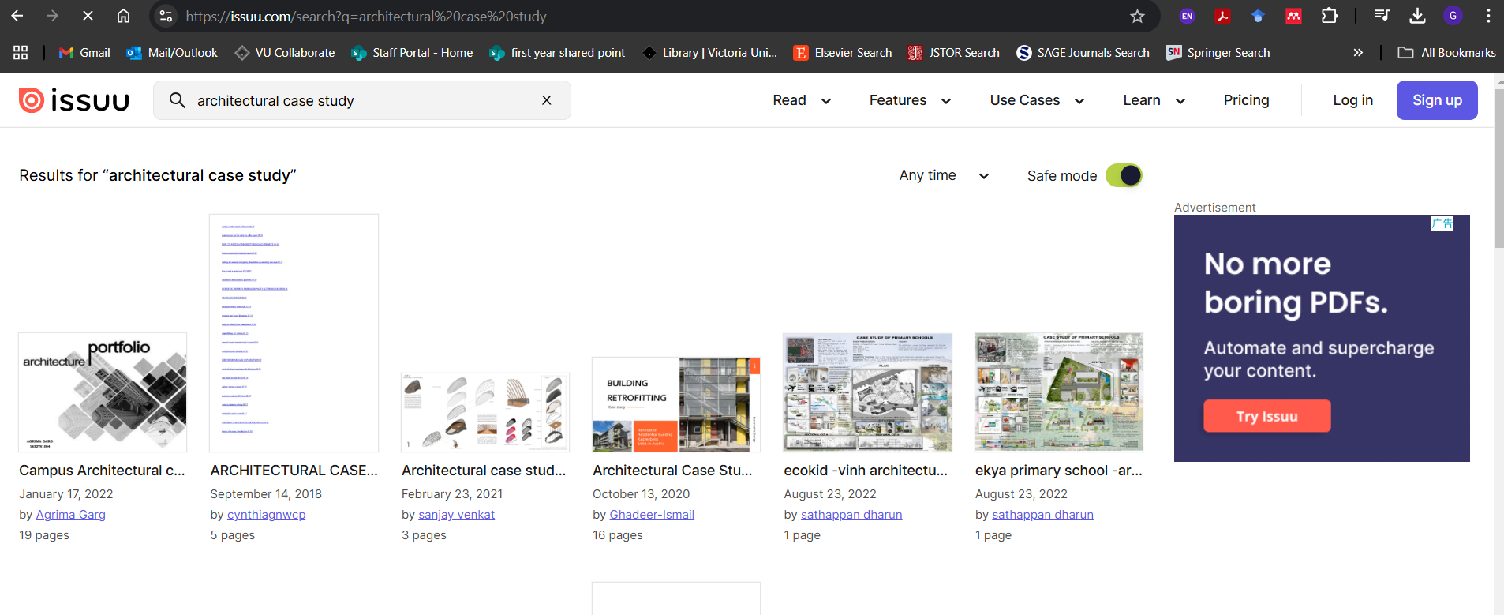
Selecting Architectural Precedents - Resources
ISSUU.com

Slide 9
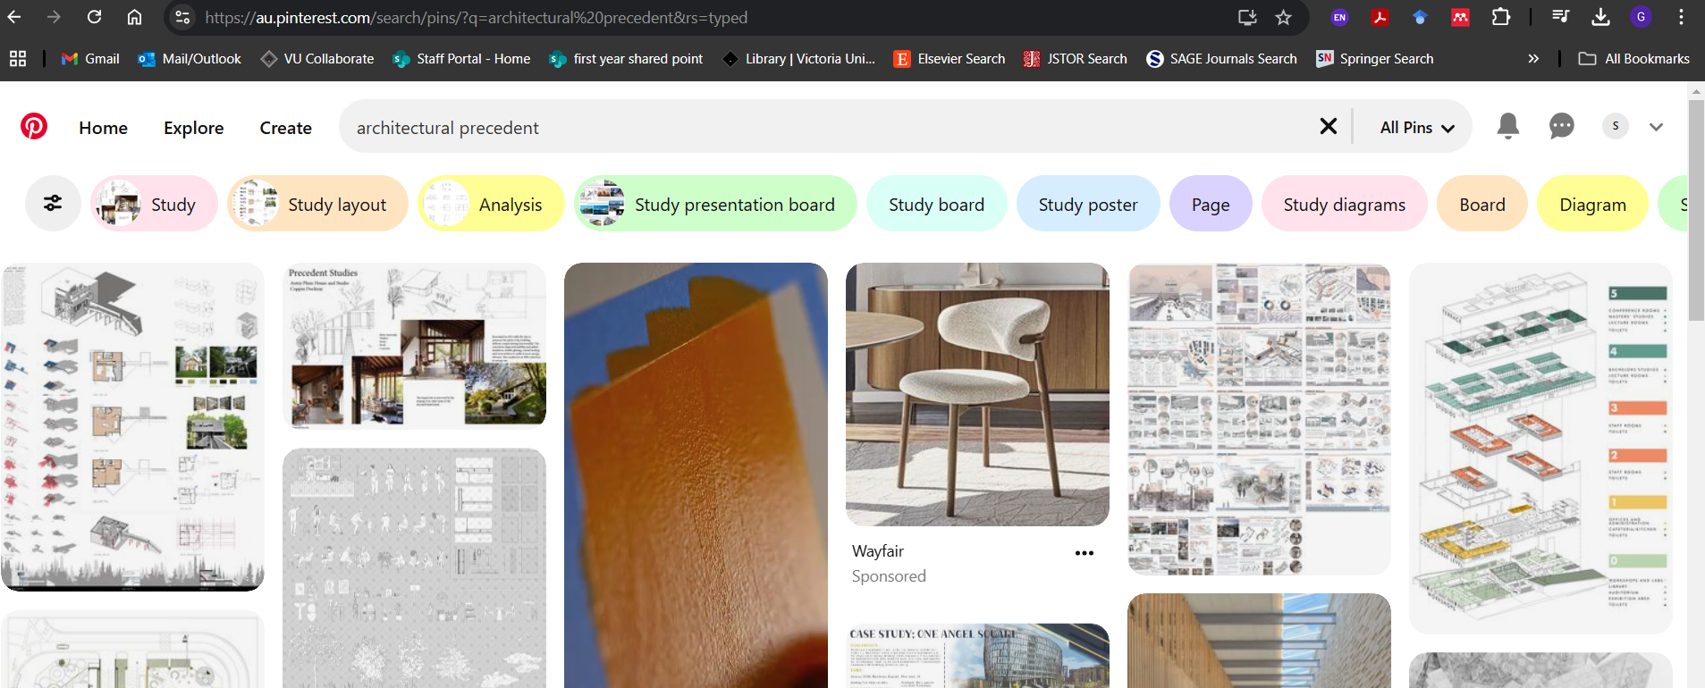
Selecting Architectural Precedents - Resources
Pinterest

Slide 10
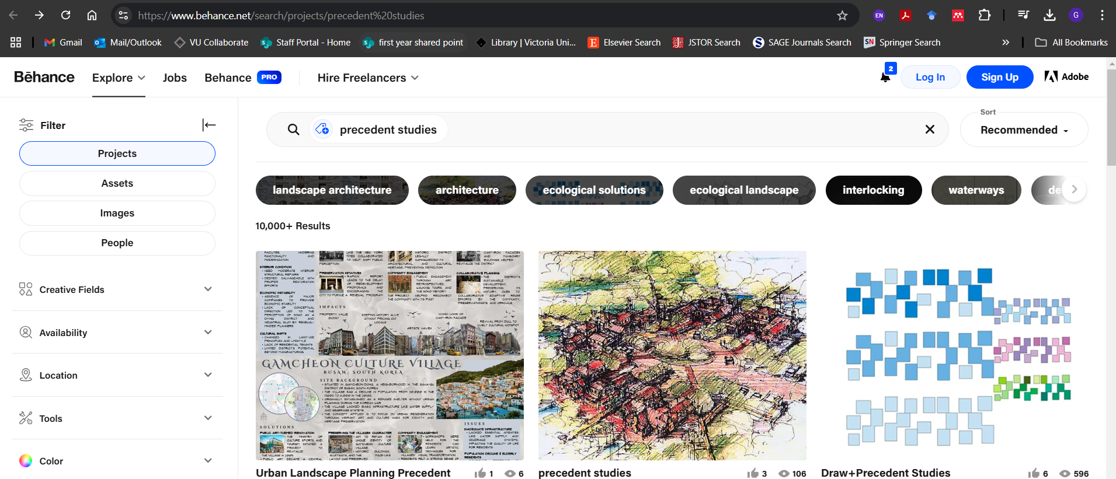
Selecting Architectural Precedents - Resources
Behance

Slide 11

Selecting Architectural Precedents - Resources
The Pritzker Architecture Prize

Slide 12
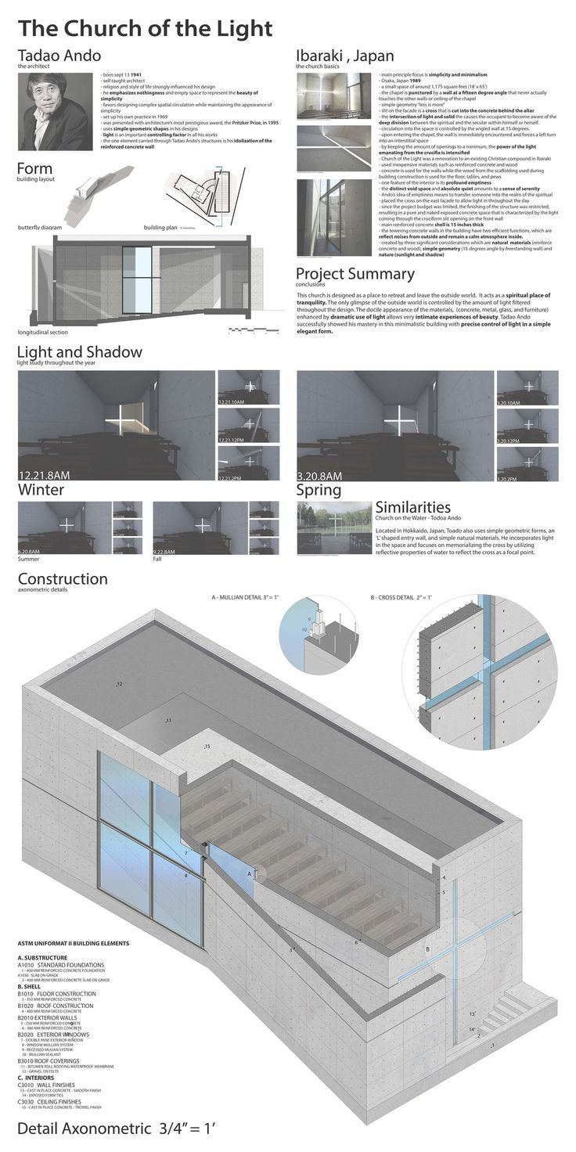
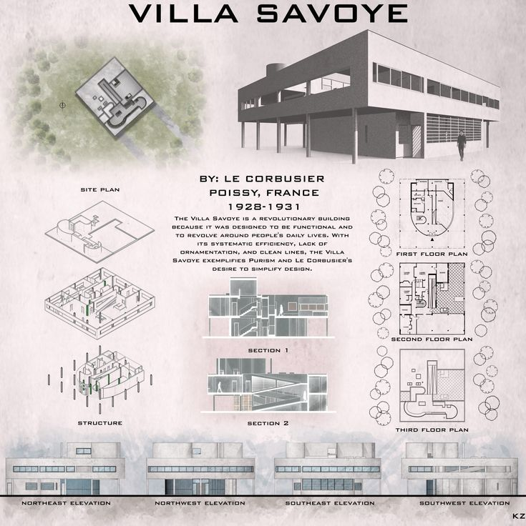
Analysing Architectural Precedents
Tools and methods for analysis: diagrams, sketches, software simulations
Source: Pinterest

Slide 13
Source of Information
Source of information: architect’s own website, architectural review, analysis conducted by others, library, database
Refer to VU library guide for course reading guide and more information

Slide 14
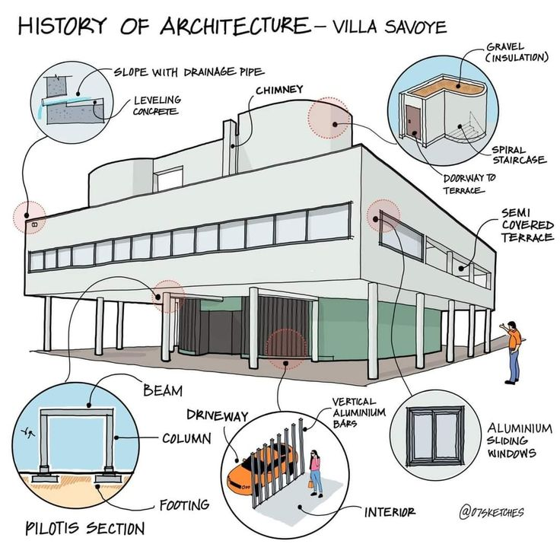
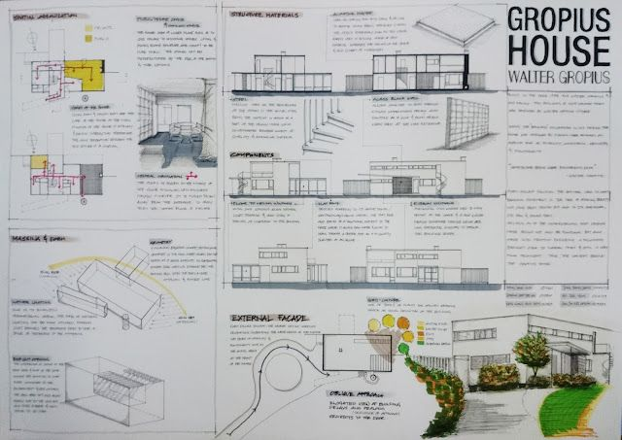
Analysing Architectural Precedents
Key aspects to analyse: design concept, use of space, materials, structural system, and environmental response
Read the sample case study from VUC
Source: Pinterest

Slide 15
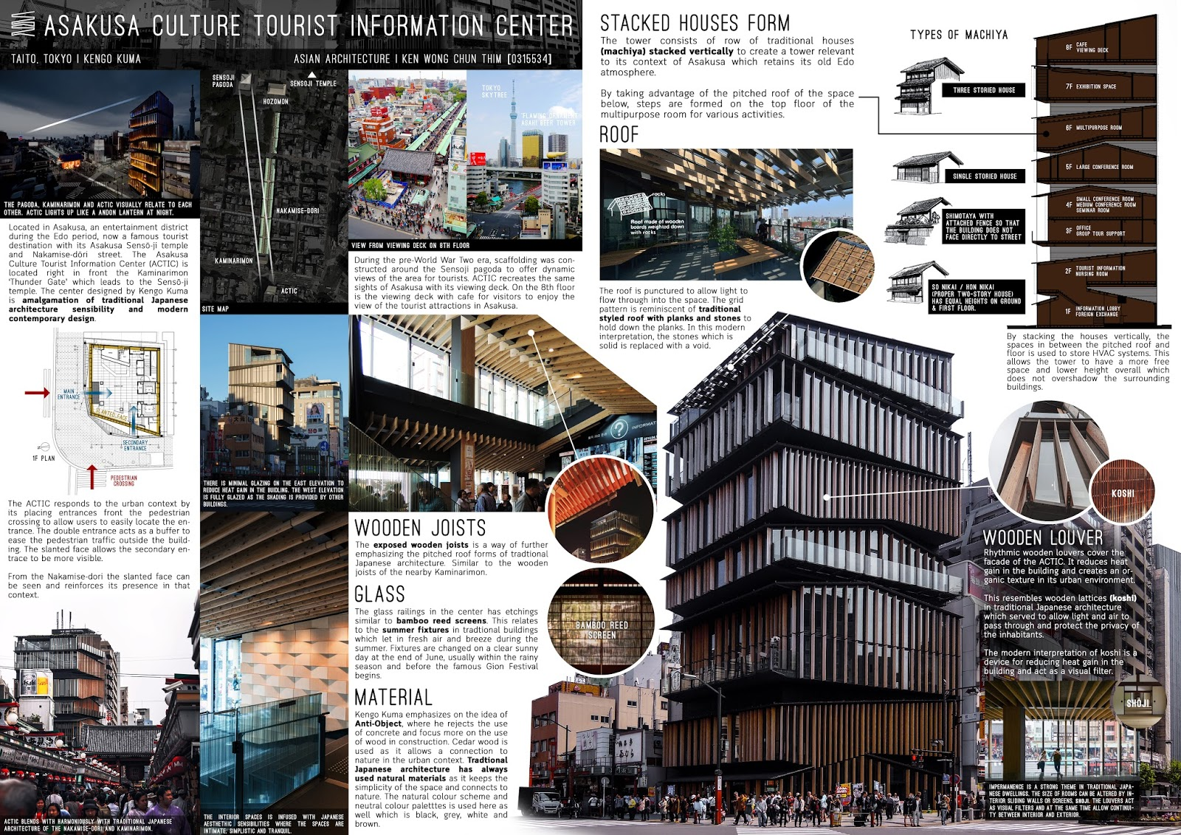
Learning from Precedents
Source: Pinterest
From the reading material:
Identifying successful elements in the precedent that can be adapted or improved
Understanding the context and constraints that shaped the design
Balancing inspiration with originality—avoiding direct imitation

Slide 16
Activity 1: Plagiarism in Architecture

Slide 17
Activity 2: Case Study Reading

Slide 18
Activity 3: Mini precedent case study

Slide 19
Session 2
Culturally Sustainable Design Strategies

Slide 20
Sustainable Design Strategies
Four Pillars of Sustainability
UNESCO
Economic
Social
Cultural
Environmental

Slide 21

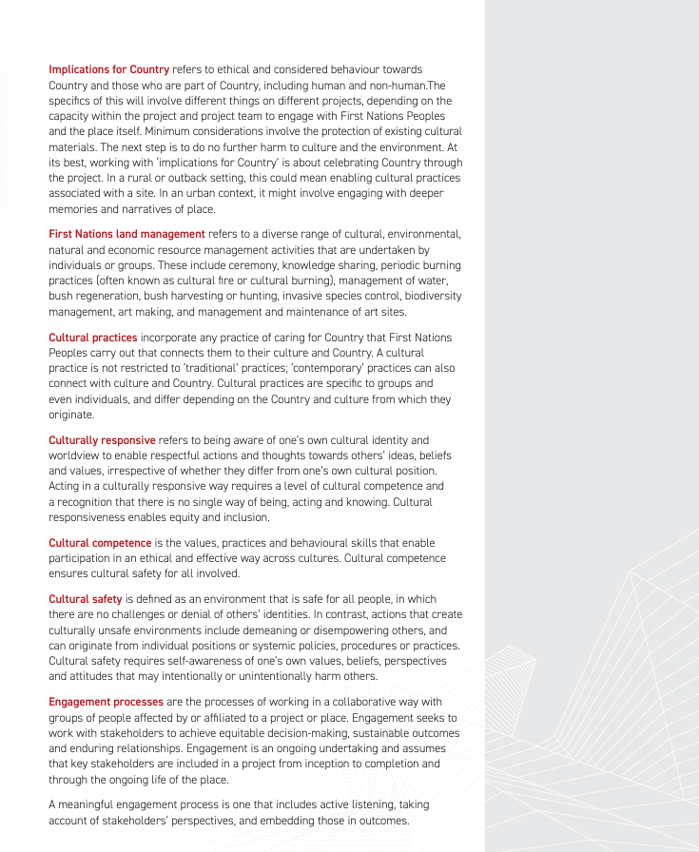
Source: National Standard of Competency for Architects 2021

Slide 22
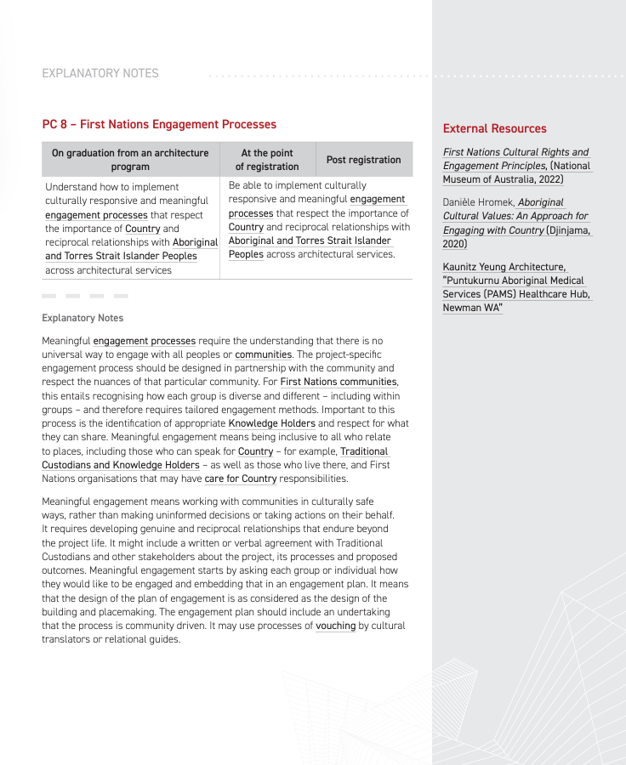
Source: National Standard of Competency for Architects 2021

Slide 23
Culturally Sustainable Design Strategies
1. Community Engagement: Inclusive Design Process, Feedback Mechanisms
2. Cultural Research: Historical Context, Preservation of Artifacts
3. Adaptation of Local Architectural Styles: Architectural Elements, Materials and Techniques
4. Sensitivity to the Built Environment: Scale and Proportion; Visual Impact
5. Sustainability and Resilience: Environmental Considerations, Adaptive Reuse
6. Education and Storytelling: Interpretative Elements, Promotion of Cultural Identity
7. Economic Sustainability: Support Local Economies
8. Legal and Ethical Considerations: Respect for Land Rights

Slide 24
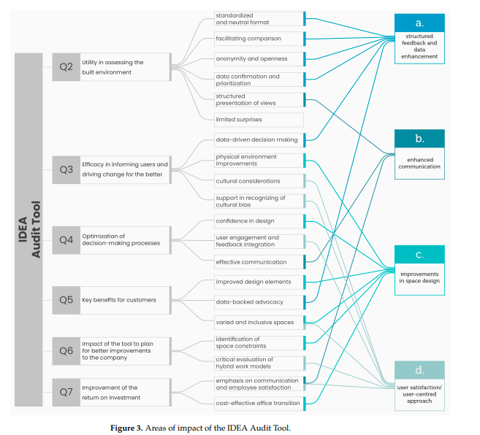
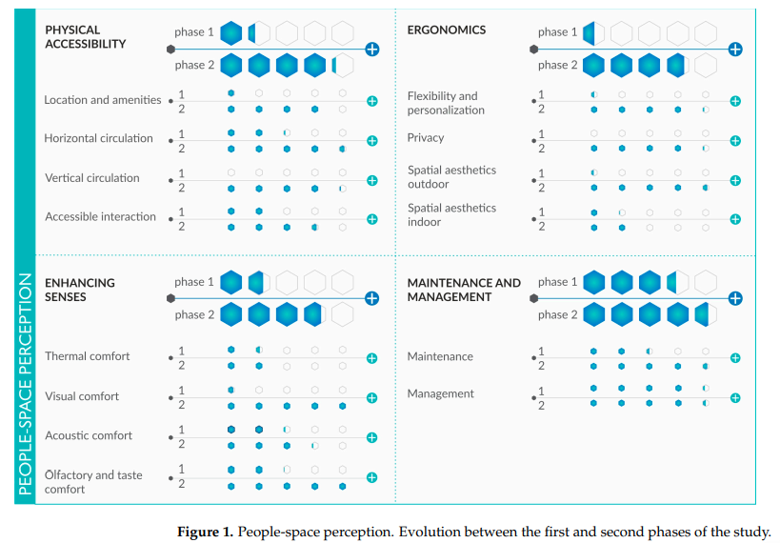
Culturally Sustainable Design Strategies Example
1. Community Engagement: Inclusive Design Process, Feedback Mechanisms
https://www.mdpi.com/2075-5309/14/9/3018
Source: Zallio et al., 2024

Slide 25
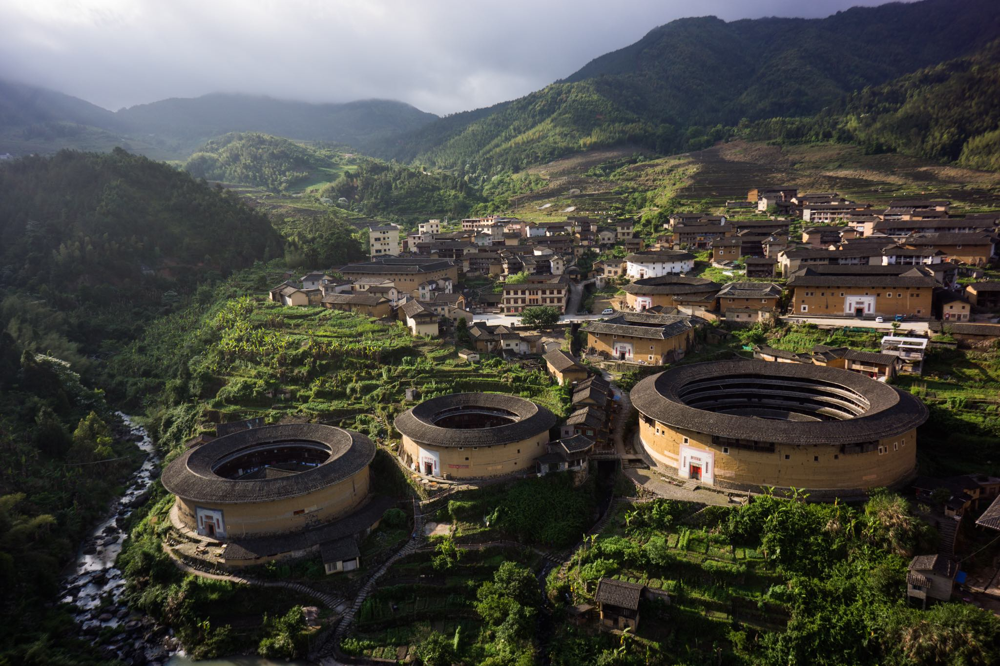


Culturally Sustainable Design Strategies Example
3. Adaptation of Local Architectural Styles: Architectural Elements, Materials and Techniques (Vernacular Housing)
https://www.archdaily.com/898253/25-examples-of-vernacular-housing-from-around-the-world
https://www.arch2o.com/vernacular-architecture/
Source: ArchDaily

Slide 26
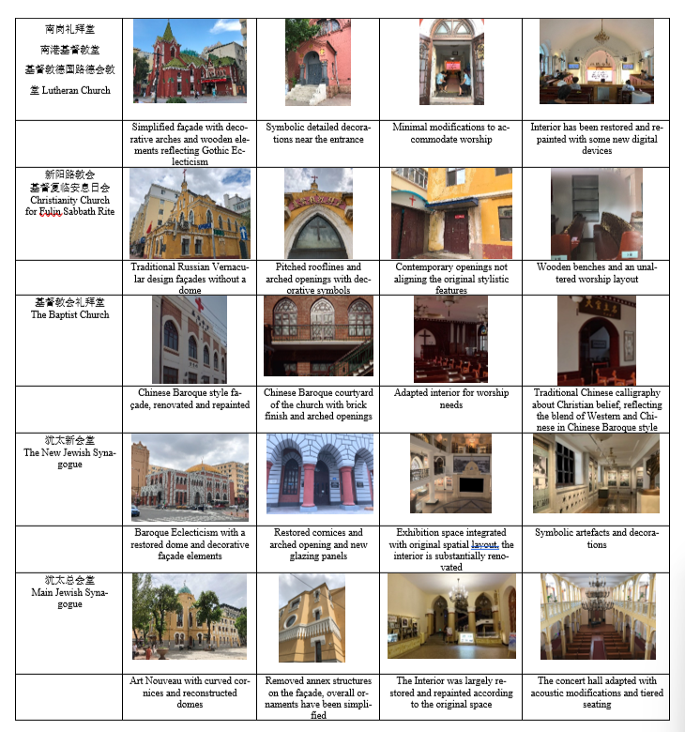
Culturally Sustainable Design Strategies Example
5. Sustainability and Resilience: Environmental Considerations, Adaptive Reuse
https://www.youtube.com/watch?v=8qdjQBRAoE8
https://www.mdpi.com/2571-9408/7/12/329
Source: Yan et al., 2024

Slide 27
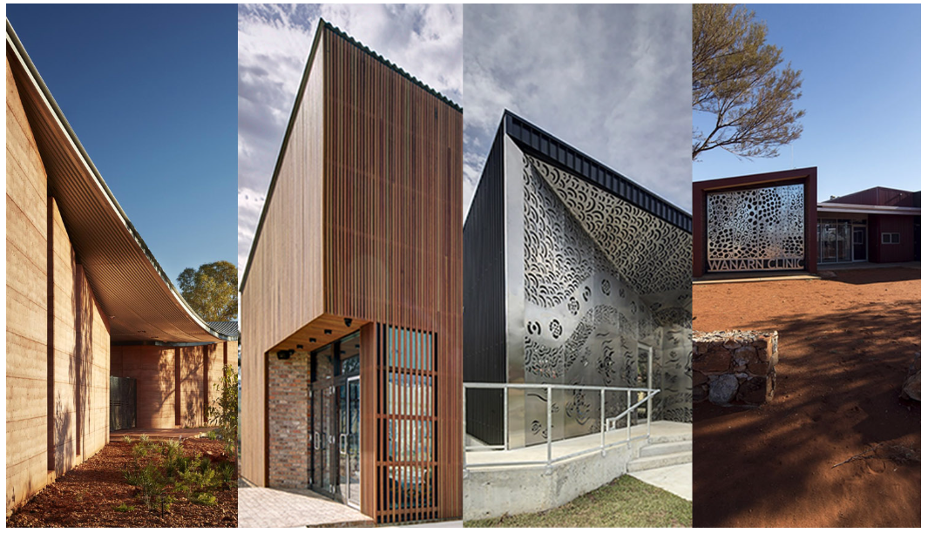
Culturally Sustainable Design Strategies Example
6. Education and Storytelling: Interpretative Elements, Promotion of Cultural Identity
https://worldarchitecture.org/article-links/evvzv/how-australian-architects-are-inspired-by-aboriginal-culture-stories-of-kaunitz-yeung-architecture.html
Source: ArchDaily

Slide 28
Activity 4: Case Study Analysis

Slide 29
References
Pinterest. (2025). Pinterest Image. https://www.pinterest.com/
Zallio, M., Chivǎran, C., & Clarkson, P. J. (2024). Exploring Inclusion, Diversity, Equity, and Accessibility in the Built Environment: A Case Study. Buildings, 14(9), 3018. https://doi.org/10.3390/buildings14093018
Architects Accreditation Council of Australia. (2021). 2021 National Standard of Competency for Architects. https://aaca.org.au/wp-content/uploads/2021-NSCA.pdf
Arch Daily. (2025). Arch Daily Image. https://www.archdaily.com/
Yan, S., Geng, S., Chau, H.-W., Wang, T., Jamei, E., & Vrcelj, Z. (2024). Adaptive Reuse of Russian-Influenced Religious Architecture in Harbin: Architectural Identity and Heritage Tourism. Heritage, 7(12), 7115-7141. https://doi.org/10.3390/heritage7120329

Slide 30
Thank you
Questions?

